Slide 1
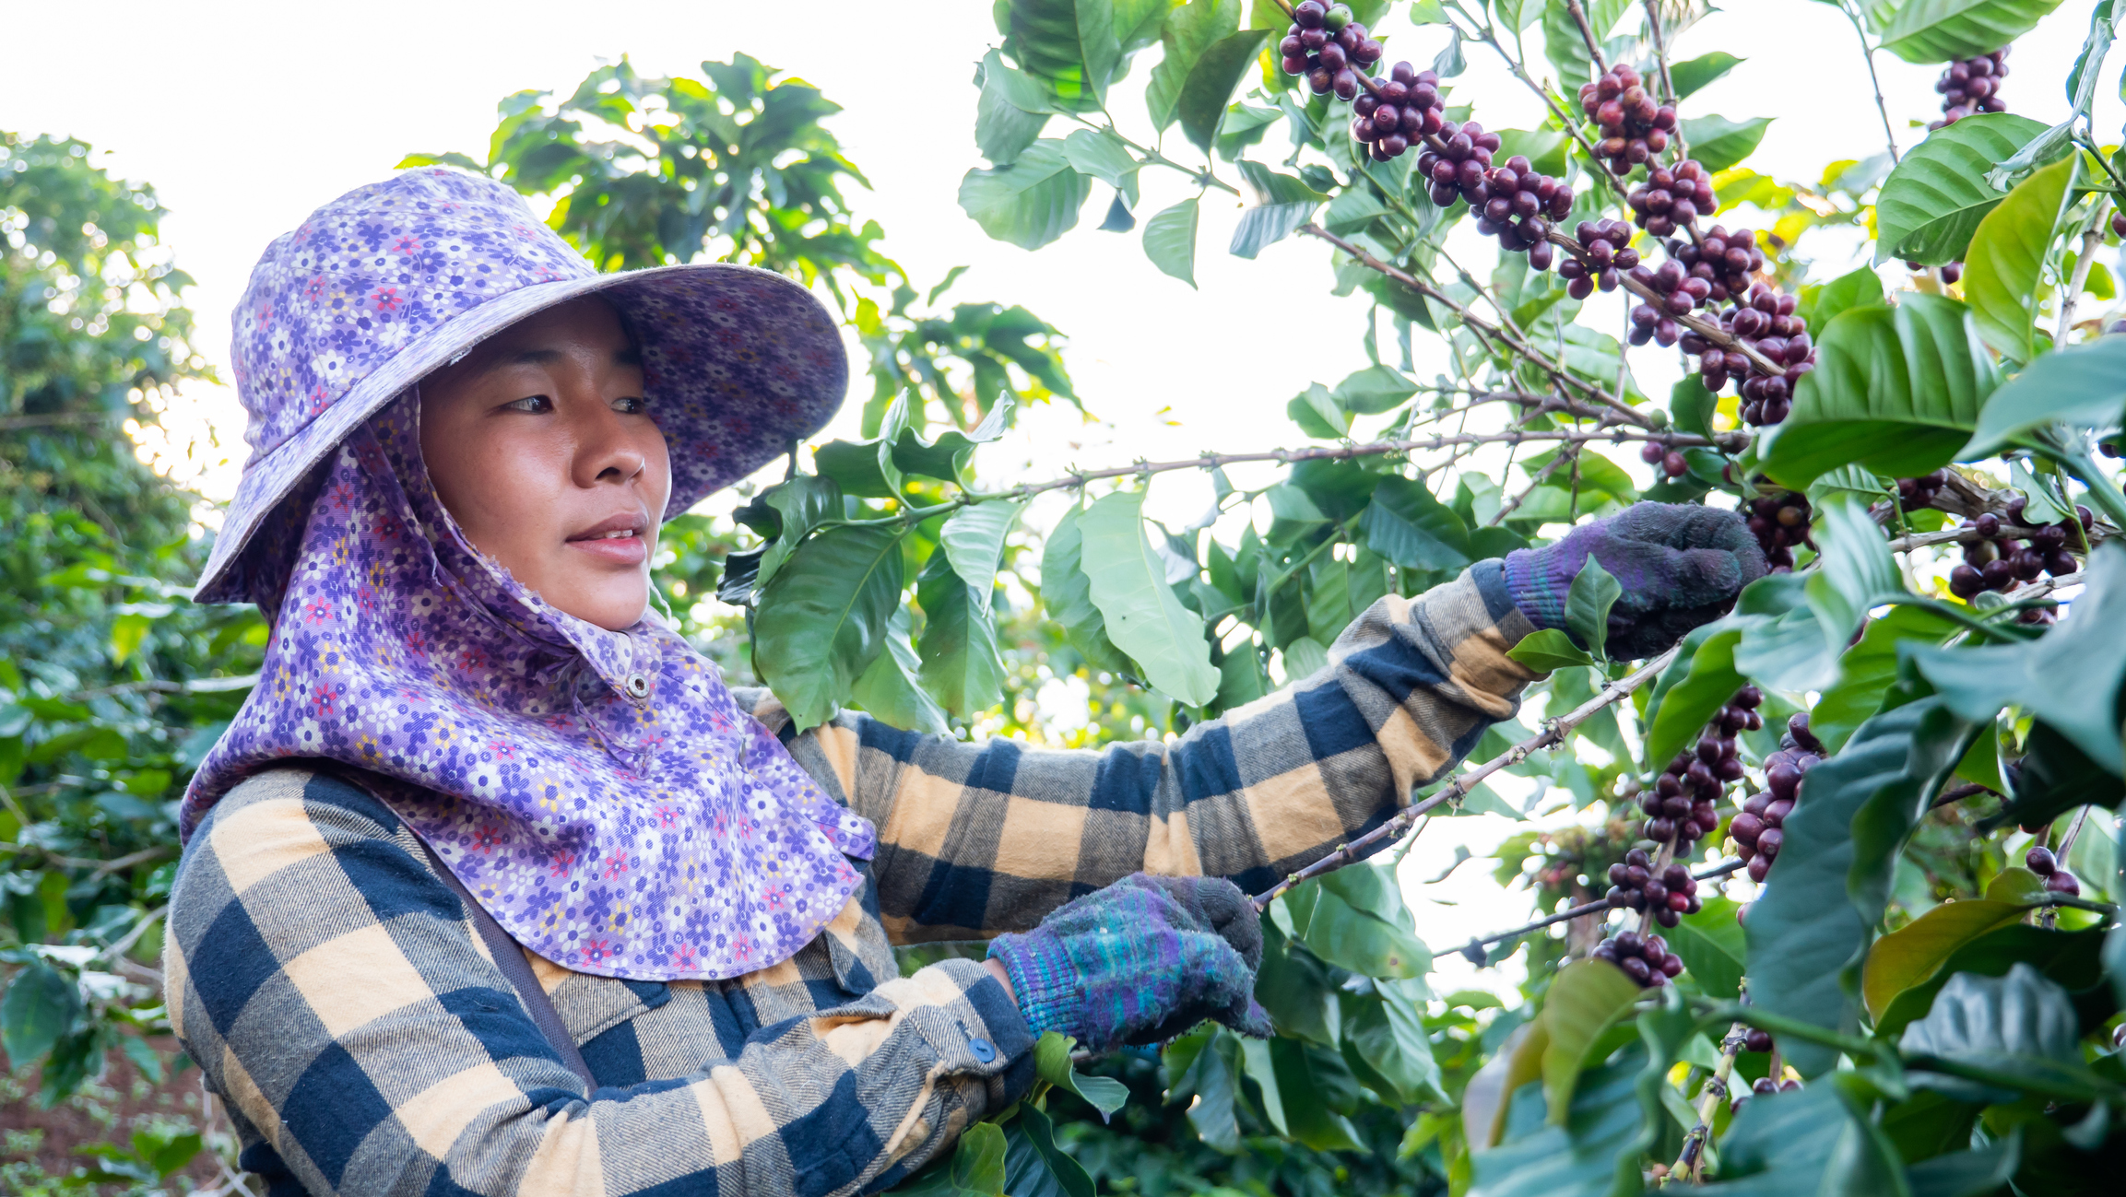
Forward chain
CryptoChicks Hatchery Participant: Lee May Nikoletos
A big thank you to CryptoChicks for this wonderful opportunity!

Slide 2
Forward chain The business goal of Forward Chain is to solve the problem of the disconnect between the food we eat and the humanity of the people who supplied it. This goal is reached by storytelling of the lives of people on the farms in addition to farming methods and certifications. Supply chain transactions using blockchain technology solves the problem of visibility in shipments which benefits retail stores and the people who want to buy food at its freshest.

Slide 3

Our project tells the story about the lives of farmers as people first. It communicates their daily life experiences on the farm. It relays challenges and successes in care of crops and animals. The journey that their produce/meat takes from farm to table is made visible with blockchain technology. Our app will not only offer a filter search for a variety of product certifications, it will also bring better understanding of those who produced the food.

Slide 4
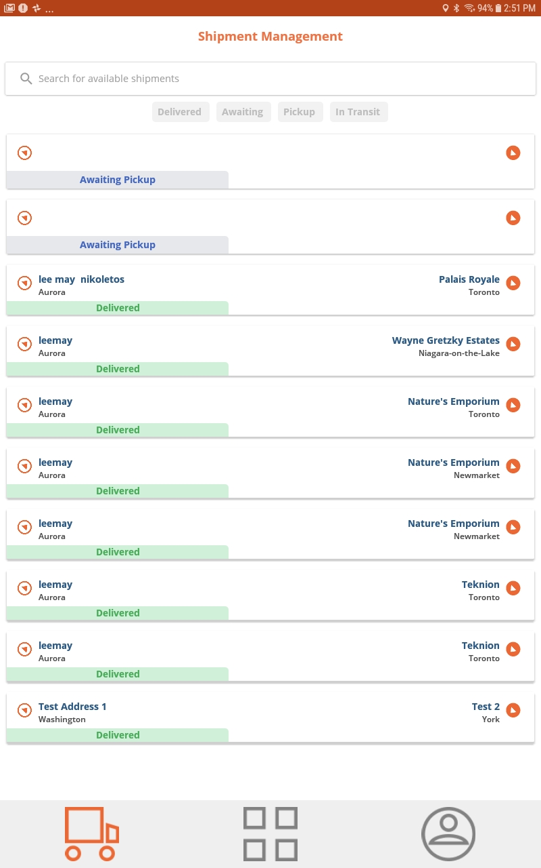

Real life testing of the shipchain mobile app

Slide 5
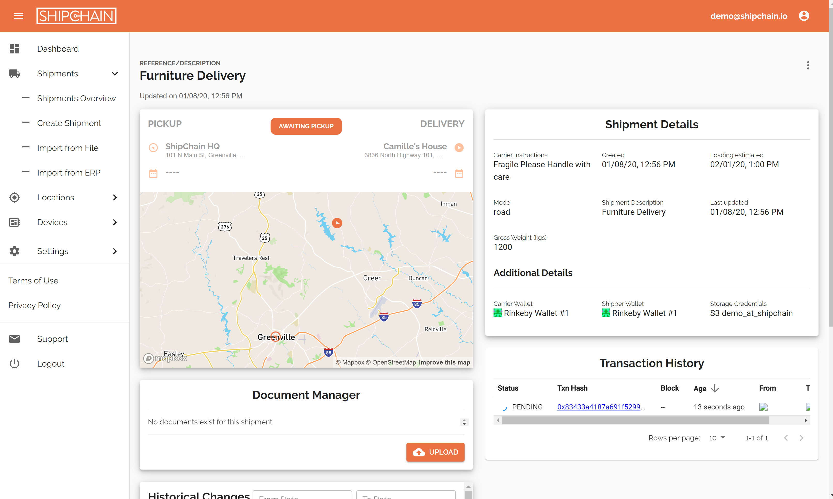

Slide 6
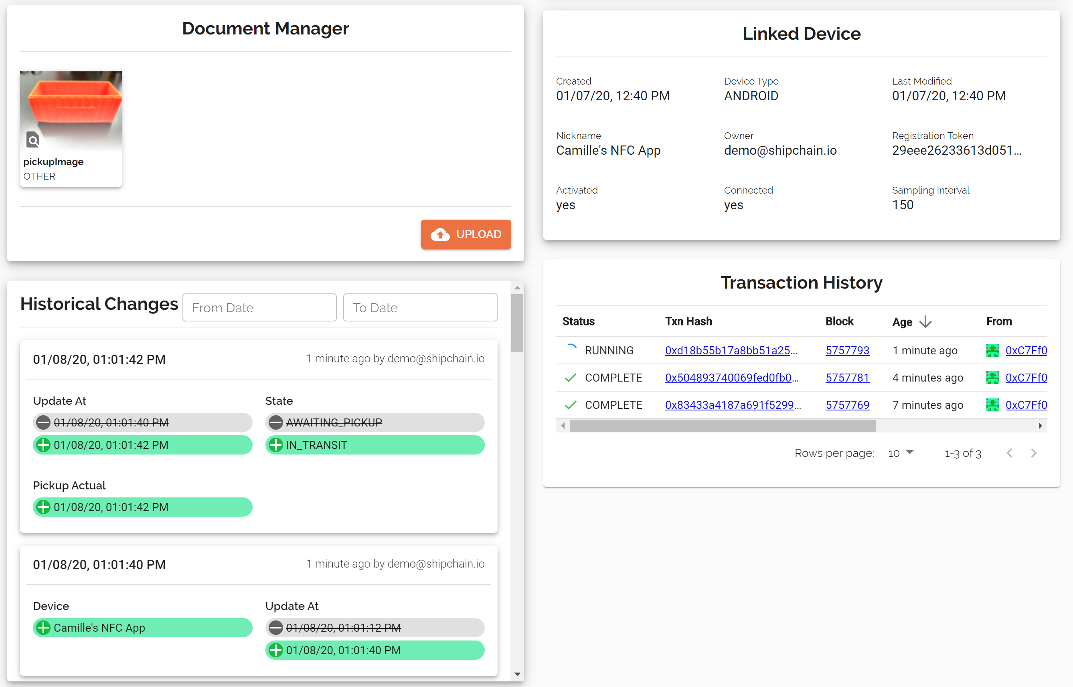

Slide 7
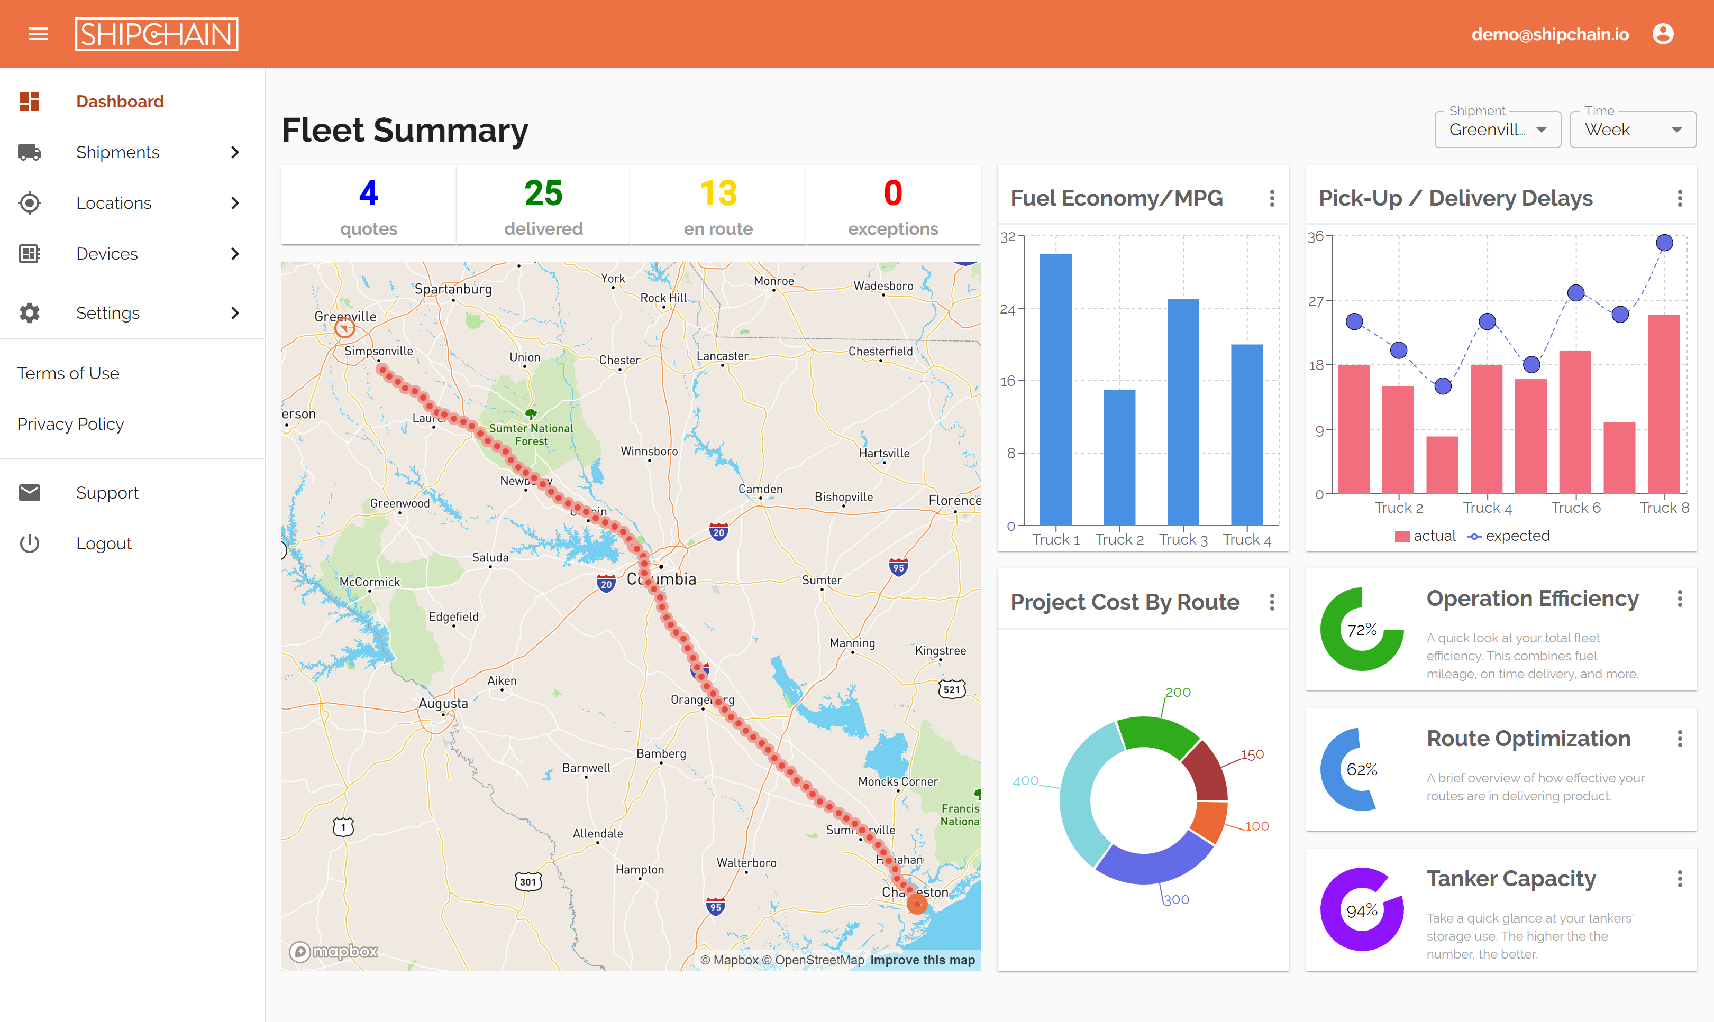
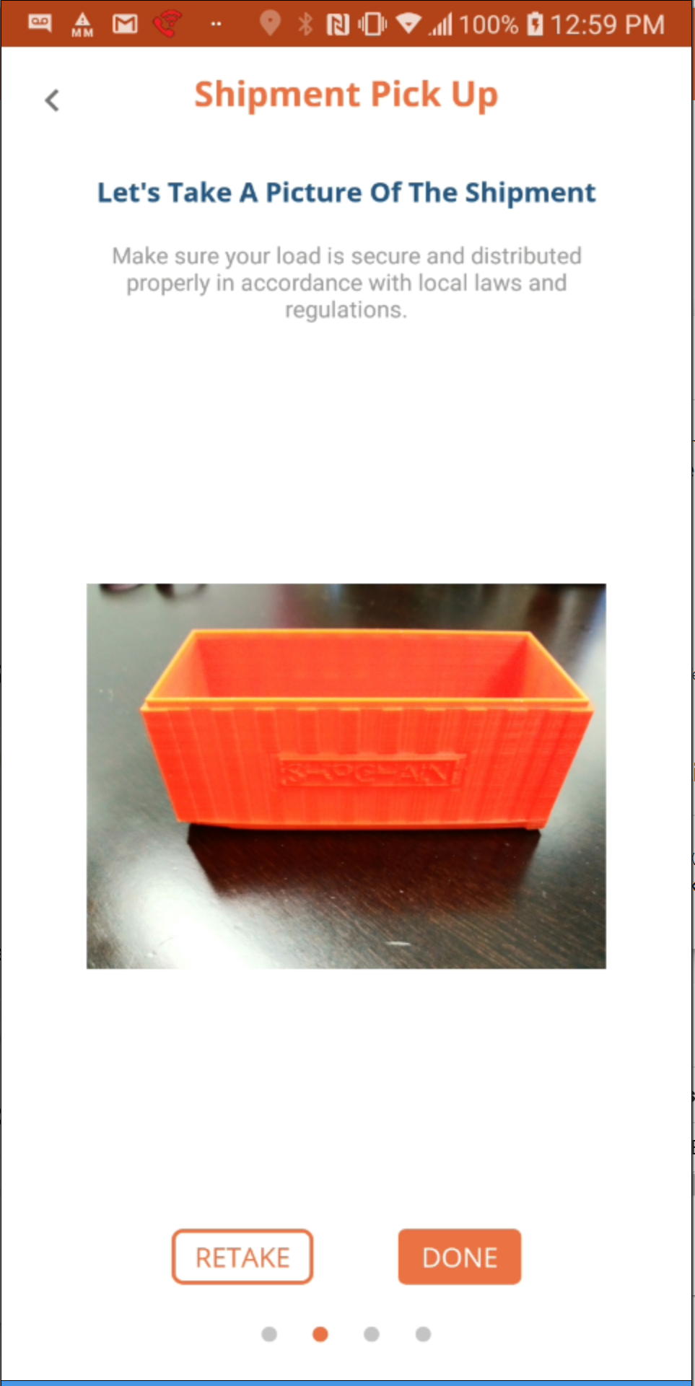
Examples of the sleek design created by shipchain
Images of product are taken at pickup and posted to the Ethereum platform.
Another image is taken at drop off to validate product integrity.
Since both images are posted to blockchain, this validation reduces disputes.

Slide 8
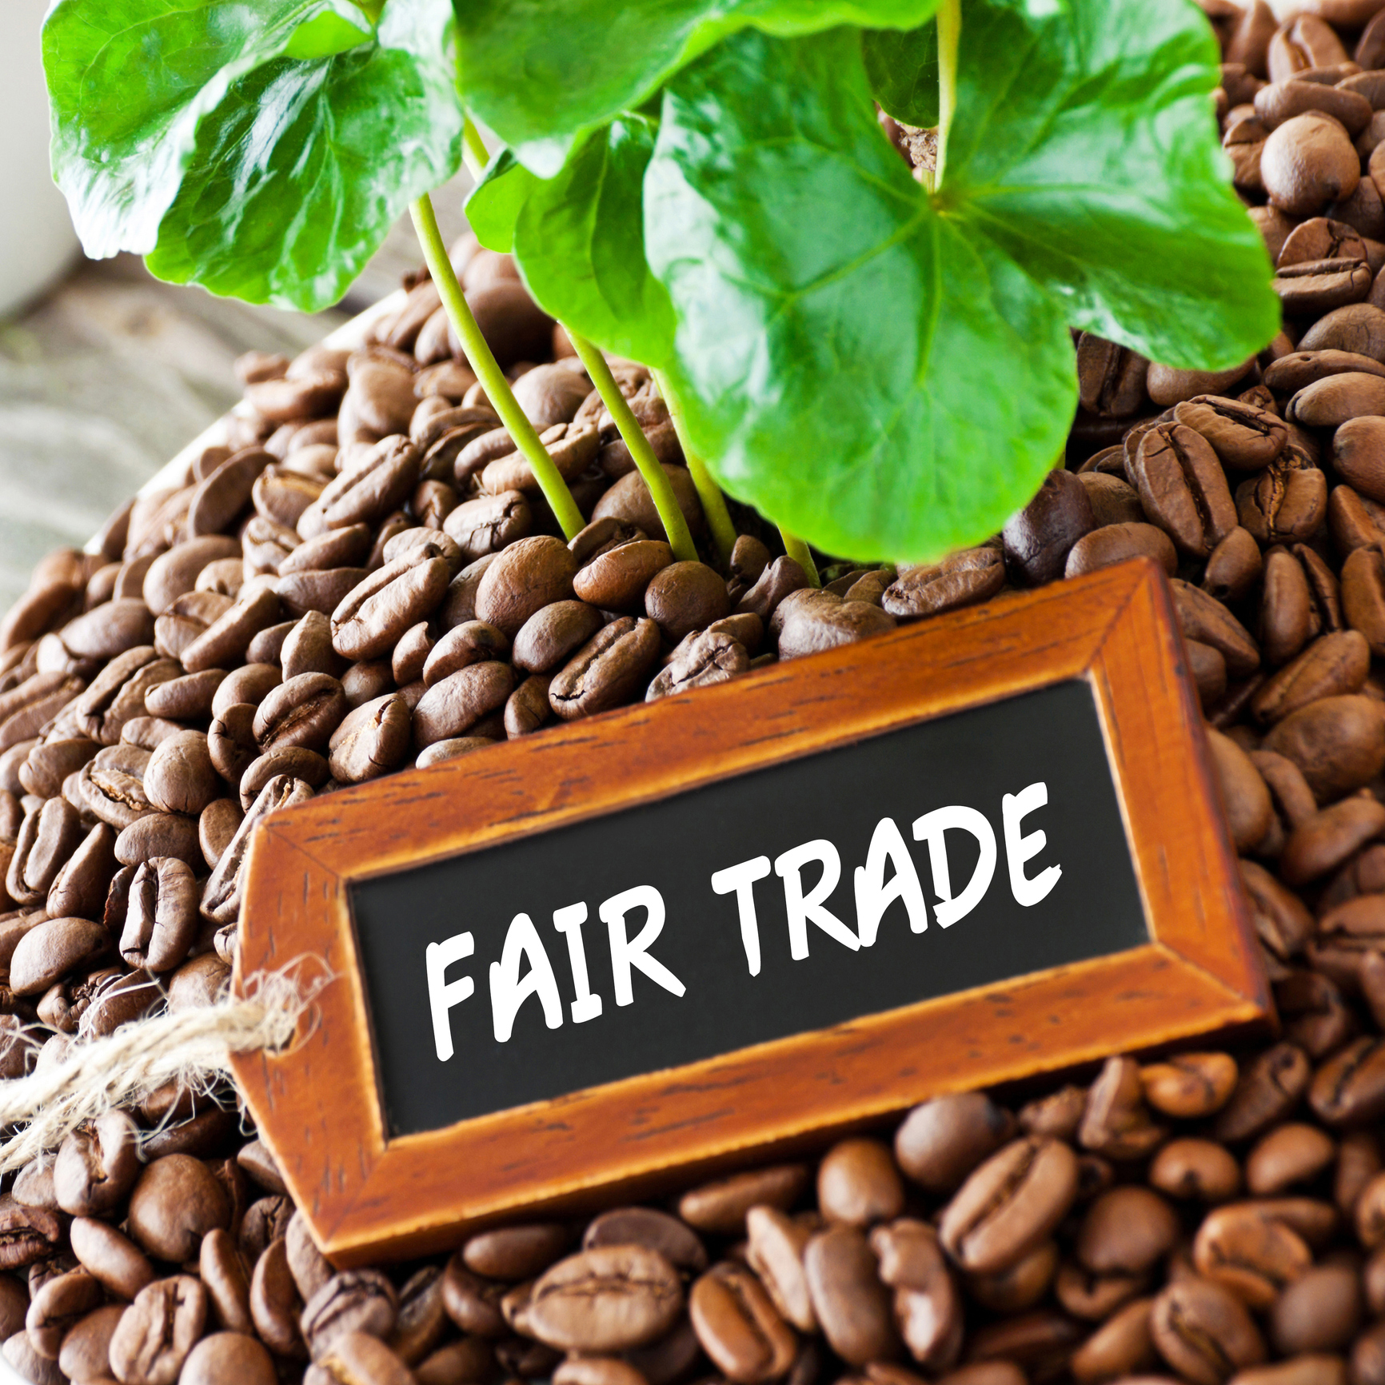

Slide 9
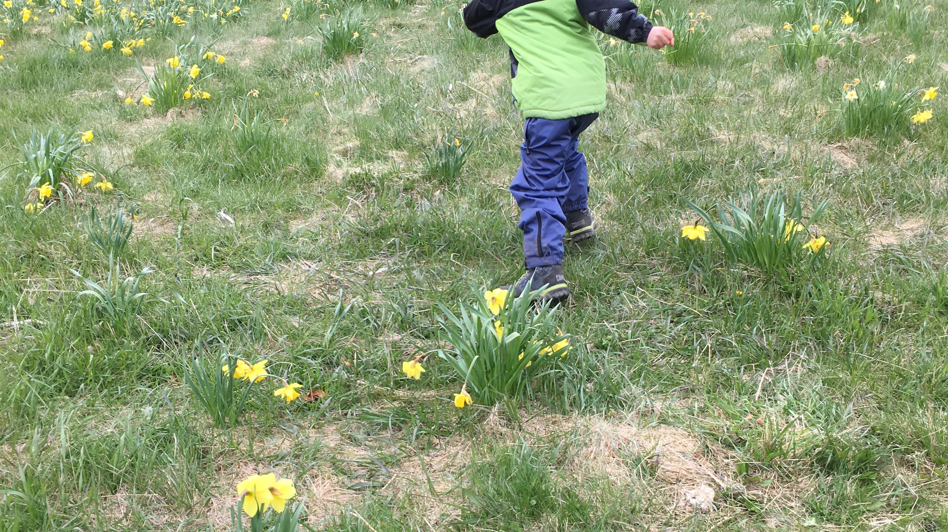
Thank you for allowing me to share my inspiration for a greater connection to the people who provide us with food.
Your time is appreciated.

